Slide 1
ORATORIO
The David Sackett 2016 Trial of the Year
Jerry S. Wolinsky, MD
Emeritus Professor in Neurology
Notes:
Function: Speaker
Session: Session 2: The David Sackett Trial of the Year Award
Presentation Title: Enrichment: lessons from ORATORIO and other trials
Length of presentation: 25 minutes plus 5 - 10 minutes discussion – Scott Evans
Date: Tuesday, 9 May 2017
Time: 05.10 – 6:00
Each year the SCT presents an award to the randomized clinical trial published (either electronically or in print) in the previous year (2016 in this case) that best fulfills the following standards:
• It improves the lot of humankind.
• It provides the basis for a substantial, beneficial change in health care.
• It reflects expertise in subject matter, excellence in methodology, and concern for study participants.
• It overcame obstacles in implementation.
• The presentation of its design, execution, and results is a model of clarity and intellectual soundness.
I am pleased to inform you that ORATORIO was selected as the 2016 Trial of the Year. We wish to invite you to present the ORATRIO trial at the joint meeting of the SCT and the International Clinical Trials Methodology Conference in Liverpool, England.

Slide 2
Accepting on behalf of my many colleagues and patients
AUSTRALIA St Vincent's Hospital Melbourne Royal Hobart Hospital
AUSTRIA Landes-Nervenklinik Wagner-Jauregg Medizinische Universität Wien Universitätsklinikum Innsbruck Christian-Doppler-Klinik Salzburg
Allgemeines Krankenhaus Linz
BELGIUM CHU Tivoli AZ Alma
BRAZIL Hospital São Lucas da PUCRS
Hospital das Clinicas da Universidade Federal de Goias
Santa Casa de Misericordia de Belo Horizonte
Hospital Universitário Clementino Fraga Filho (UFRJ)
BULGARIA Multiprofile Hospital for Active Treatment “National Cardiology Hospital” Multiprofile Hospital for Active Treatment of Neurology and Psychiatry "Sv. Naum“
CANADA Montreal Neurological Institute and Hospital Ottawa Hospital Recherche Sepmus, Inc. Health Sciences Centre St. Michael's Hospital University of British Columbia Hospital Foothills Medical Centre
CZECH REPUBLIC Fakultni nemocnice Brno Vseobecna fakultni nemocnice v Praze Krajska zdravotni, a.s. - Nemocnice Teplice, o.z.
FINLAND Turun yliopistollinen keskussairaala Tampereen yliopistollinen sairaala Helsingin yliopistollinen keskussairaala / Meilahti
FRANCE Centre Hospitalier Universitaire de Bordeaux, Hopital Pellegrin
CHU Gui De Chauliac
Groupe hospitalo-universitaire Caremeau
Hopital Purpan
Hopital Gabriel Montpied
Hôpital de Hautepierre
CHRU Nancy
Hôpital Côte de Nacre
Fondation Rothschild
Hôpital de Poissy
Hôpital Guillaume et René Laënnec
Hôpital Pasteur
Groupe Hospitalier Pitié- Salpétrière
Hôpitaux de La Timone
Hôpital Maison Blanche
Hôpital Roger Salengro
Hôpital Pierre Wertheimer - Hôpital Neurologique
GERMANY Medizinische Einrichtungen des Bezirks Oberpfalz GmbH
Universitätsklinikum Gießen und Marburg GmbH
Universitätsklinikum Frankfurt
Heinrich Heine Universität Düsseldorf
C/O Jüdisches Krankenhaus
Charité - Universitätsmedizin Berlin
Klinikum rechts der Isar der Technische Universität München
Ruhr-Universität Bochum
Marianne-Strauß-Klinik
Deutsche Klinik für Diagnostik GmbH
Kliniken der Stadt Köln gGmbH
Universitätsklinikum Münster
Klinikum Bayreuth GmbH
Universität Heidelberg
Universitätsklinikum Leipzig
Universitätsklinikum Ulm
Universitätsklinikum Tübingen
Universitätsklinikum Carl Gustav Carus an der TU Dresden
GREECE 401 Military Hospital of Athens "AHEPA" University General Hospital of Thessaloniki "Georgios Papanikolaou" General Hospital of Thessaloniki
HUNGARY Uzsoki Utcai Kórház
Pécsi Tudományegyetem
Jahn Ferenc Dél-Pesti Kórház és Rendelöintézet
Vaszary Kolos Kórház
Clinexpert Egészségügyi Szolgáltató és Kereskedelmi Kft.
Szegedi Tudományegyetem Szent-Györgyi Albert Klinikai Központ
ISRAEL The Chaim Sheba Medical Center
Rabin Medical Center
Tel Aviv Sourasky Medical Center
Hadassah University Hospital Ein Kerem
Barzilai Medical Center
ZIV Medical Center
ITALY Azienda Sanitaria Ospedaliera S. Luigi Gonzaga
Ospedale San Raffaele S.r.l.
Ospedale Binaghi
Azienda Ospedaliera Universitaria San Martino
LITHUANIA Klaipeda University Hospital
Hospital of Lithuanian University of Health Sciences Kaunas Clinics Republican Siauliai Hospital
MEXICO Grupo Médico Camino Centro de Estudios Clinicos y Especialidades Medicas SC Instituto Nacional de Neurologia y Neurocirugia Instituto Biomédico de Investigación A.C.
NETHERLANDS Erasmus MC Orbis Medisch Centrum
NEW ZEALAND Waikato Hospital
Wellington Hospital
NORWAY Oslo universitetssykehus HF, Ullevål
PERU Clinica Anglo Americana Hospital Dos de Mayo Hospital IV Alberto Sabogal Sologuren
POLAND Akson Clinical Research Maciejowski-Bielecki Sp. j. Zespol Opieki Zdrowotnej w Konskich Niepubliczny Zaklad Opieki Zdrowotnej KENDRON M.A. - LEK A.M. Maciejowscy SC. Centrum Terapii SM SPZOZ Uniwersytecki Szpital Kliniczny nr 1 im. Norberta Barlickiego Uniwersytetu Medycznego w Lodzi
Centrum Neurologii Krzysztof Selmaj Samodzielny Publiczny Szpital Kliniczny nr 4 Niepubliczny Zaklad Opieki Zdrowotnej NEURO-MEDIC
PORTUGAL Centro Hospitalar e Universitário de Coimbra, EPE
Hospital Garcia de Orta
Centro Hospitalar Lisboa Norte, E.P.E.
Hospital Fernando Fonseca
Centro Hospitalar do Porto – Hospital de Santo António
ROMANIA Targu Mures Emergency County Clinical Hospital
SC Clubul Sanatatii SRL
"Elias" Emergency University Hospital
Timisoara Emergency County Clinical Hospital
RUSSIA Research Medical Complex "Vashe Zdorovie“
SPAIN Hospital Universitario Ramón y Cajal
Hospital Clinico San Carlos
Hospital de la Santa Creu i Sant Pau
Hospital Regional Universitario de Malaga – Hospital General
Hospital Universitario Vírgen Macarena
Hospital del Mar
Hospital Universitario de La Princesa
Hospital Universitario Vall d'Hebron
Hospital Universitario de Donostia
Hospital General Universitario de Alicante
Hospital Clinico Universitario de Santiago
Hospital Universitari de Girona Dr Josep Trueta
Organización Sanitaria Integrada Bilbao Basurto
Hospital Clinic de Barcelona
SWITZERLAND Ospedale Regionale Lugano Civico Universitätsspital Basel
UKRAINE Municipal Institution of Kyiv Regional Council "Kyiv Regional Clinical Hospital"
Municipal Institution “Odesa Regional Clinical Hospital"
State Treatment and Prevention Institution “Central Clinical Hospital of Ukrzaliznytsya”
SI "Ukrainian State Research Institute of Medical and Social Problems of Disability" MOH of Ukraine
Vinnytsya National Medical University n.a. M.I. Pyrohov
Lviv Regional Clinical Hospital
Bukovinian Medical State University
Municipal Institution “Dnipropetrovsk Regional Clinical Hospital n.a. I.I. Mechnykov” Volyn Regional Clinical Hospital
Kyiv City Clinical Hospital #4
"State Institution ""Institute of Neurology, Psychiatry and Narcology of NAMS of Ukraine“
UNITED KINGDOM King's College Hospital
Queen's Medical Centre
Royal Victoria Infirmary
Barts and the London NHS Trust
The Walton Centre For Neurology And Neurosurgery
UNITED STATES University of California, Davis
Legacy Health System
Multiple Sclerosis Center of California
Wayne State University
Swedish Medical Center
University of Minnesota
Mayo Clinic-Scottsdale
Henry Ford Health System
Carolinas Medical Center
Sutter East Bay Medical Foundation
Washington University
MS Specialty Clinic University of New Mexico
Central Texas Neurology
Raleigh Neurology Associates, PA
University of Texas Southwestern
Center for Neurology and Spine
Winthrop University Hospital
Comprehensive Multiple Sclerosis Care Center at South Shore Neurologic Associates, PC
Phoenix Neurological Associates
Maxine Mesinger MS Clinic/Baylor College of Medicine
Neurology Associates Of Stony Brook
University of Kansas Medical Center
Trustees of the University of Pennsylvania
Indiana University Cancer Center
Icahn School of Medicine at Mount Sinai
University of Colorado
St Joseph's Hospital Barrow Neurology Clinics
Weill Medical College of Cornell University
Oklahoma Medical Research Foundation
Holy Name Hospital
Ohio State University Medical Center
The Neurology Foundation, Inc.
Michigan Institute For Neurological Disorders
MidAmerica Neuroscience Institute
Neurological Associates, Inc
MS Center of Vero Beach
University Of Miami
Neurology Clinic, PC
University of California, San Francisco
NeuroRx Research (Montreal, QC, Canada) for evaluation of MRI scans
Members of the independent data monitoring committee for performing data analysis and safety monitoring:
Stephen C. Reingold, PhD (Chair)
Magnhild Sandberg-Wollheim, MD, PhD (Vice Chair)
Frederik Barkhof, MD
Israel Steiner, MD
Scott Evans, PhD
Henry F. McFarland, MD
Thomas Dörner, MD
ORATORIO Study Steering Committee:
Douglas L. Arnold, MD
Amit Bar-Or, MD
Giancarlo Comi, MD
Jérôme de Seze, MD
Gavin Giovannoni, MD
Hans-Peter Hartung, MD
Stephen L. Hauser, MD
Bernhard Hemmer, MD
Ludwig Kappos, MD
Fred Lublin, MD
Xavier Montalban, MD
Kottil Rammohan, MD
Krzysztof Selmaj, MD
Anthony Traboulsee, MD
Jerry Wolinsky, MD

Slide 3
Disclosures
Over the past 2 years, Dr. Wolinsky has served on advisory boards, data monitoring or steering committees, has consulting agreements, or received speaker honoraria from the following entities: AbbVie, AcademicCME, ACTRIMS, Alkermes, Bayer HealthCare, Biogen, Bionest, Celgene, Clene Nanomedicine, CMSC, ECTRIMS, Forward Pharma A/S, Medday Pharmaceuticals, Novartis Pharmaceuticals, PRIME, Roche Genentech, Sanofi Genzyme, Strategic Consultants International, Takeda, Teva Pharmaceuticals, WebMD.
Royalties are received for out licensed monoclonal antibodies through UTHealth to Millipore (Chemicon International) Corporation.
No stock options or investments outside of managed retirement programs in pharmaceuticals or medical industry.
Notes:
Fully updated as a 2-year statement as of 5/06/2017

Slide 4
A Brief Primer on Multiple Sclerosis

Slide 5
Essential Multiple Sclerosis ‘Facts’
The most common non-traumatic central nervous system disorder of young adults affecting over 2.5 million persons worldwide
Geographic variations in disease incidence and prevalence suggest that strong environmental factors influence disease susceptibility and may precipitate attacks
In excess of 200 gene polymorphisms contribute to disease risk, many of these are related to immune function, but as yet none are associated with disease severity or clinical phenotypes
While evidence for an immunopathogenic basis for this demyelinating disorder is substantial, its etiology remains unknown
Relapse onset cases show an increasing female predominance, and likely an increasing prevalence of the disease overall
The pace of changing diagnostic criteria, improved imaging tools, and the influence of an expanding number of disease modifying therapies, confound trial design

Slide 6
Heterogeneity of Presentations
Relapsing Forms of MS
Progressive Forms of MS
RIS
CIS
Relapsing MS (RMS)
Secondary Progressive MS (SPMS)
Primary Progressive MS (PPMS)
Relative Disability
Conversions Over Time
Lublin et al Neurology 46:907-11, 1996; Okuda et al Neurology 72:800-5, 2009;
Lublin et al Neurology 83:278 - 86, 2014; Kantarci et al Ann Neurol 79:288-79, 2016
Notes:
Methods: Through the Swedish MS registry we investigated the proportion of PPMS diagnosis in birth, diagnosis and age period cohorts using Poisson regression.
Results: A total of 16,915 patients were categorised into six birth-cohorts from 1946 to 1975 and seven date-of-diagnosis-cohorts from 1980 to 2014. We observed a decrease in the uncorrected analysis of diagnosis of PPMS from 19.2% to 2.2% and an average decrease of 23% (p < 0.001) per 5-year birth-
cohort in the adjusted analysis. An average 21% (p < 0.001) decrease per diagnosis-cohort was seen. In the age-specific diagnosis period cohorts the same decreasing trend of PPMS diagnosis was observed in almost all groups.

Slide 7
Heterogeneity of Phases
Relapsing Phase MS
Progressive Phase MS
RIS
CIS
Relapsing MS (RMS)
Progressive MS (SPMS) (PPMS)
Relative Disability
Conversions Over Time
Lublin et al Neurology 46:907-11, 1996; Okuda et al Neurology 72:800-5, 2009;
Lublin et al Neurology 83:278 - 86, 2014; Kantarci et al Ann Neurol 79:288-79, 2016
Notes:
Methods: Through the Swedish MS registry we investigated the proportion of PPMS diagnosis in birth, diagnosis and age period cohorts using Poisson regression.
Results: A total of 16,915 patients were categorised into six birth-cohorts from 1946 to 1975 and seven date-of-diagnosis-cohorts from 1980 to 2014. We observed a decrease in the uncorrected analysis of diagnosis of PPMS from 19.2% to 2.2% and an average decrease of 23% (p < 0.001) per 5-year birth-
cohort in the adjusted analysis. An average 21% (p < 0.001) decrease per diagnosis-cohort was seen. In the age-specific diagnosis period cohorts the same decreasing trend of PPMS diagnosis was observed in almost all groups.

Slide 8
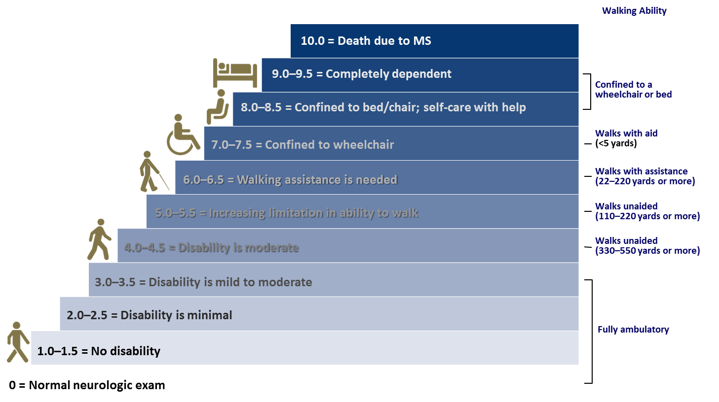
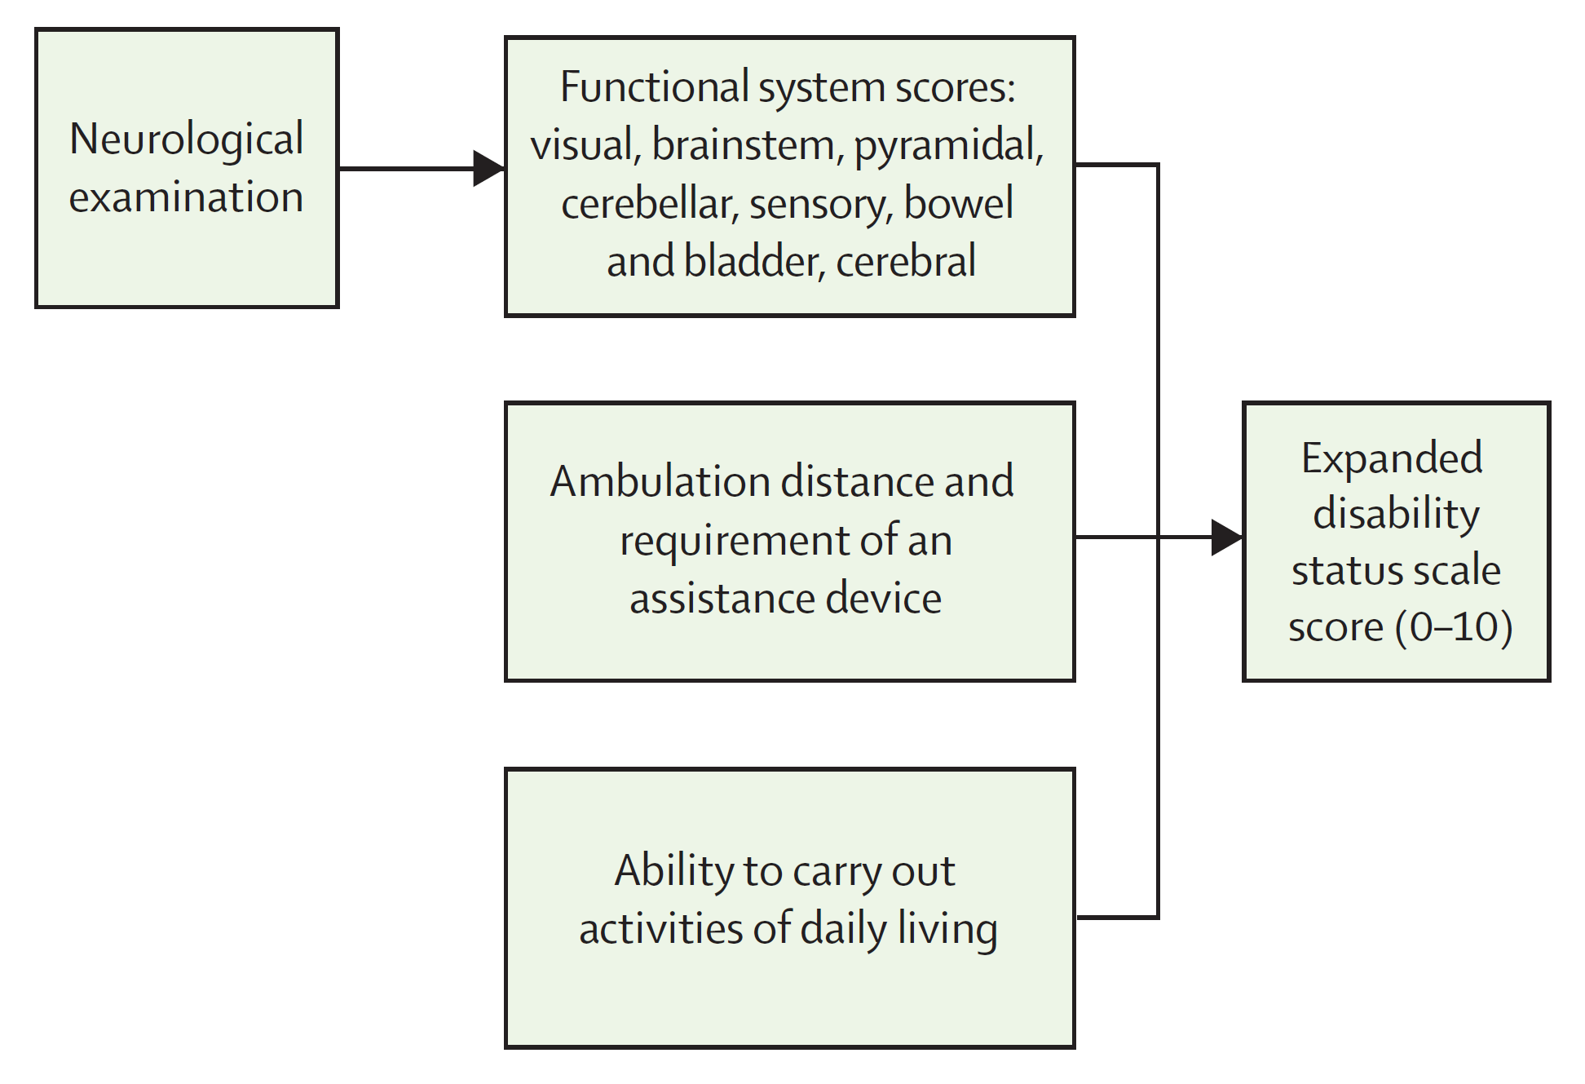
EDSS (Expanded Disability Status Scale)
A categorical, questionably ordinal composite score based on neurological history and exam, statistically often treated as if continuous
Functional systems
Ambulation
Pyrami-dal
Cere-bellar
Brain-stem
Sensory
Bowel and bladder
Visual
Cerebral
Kurtze Neurology 33:1444 - 52, 1983
Notes:
EDSS assessment in ORATORIO
All EDSS assessments were done by trained and certified examiners (www.neurostatus.net) blinded to treatment allocation and not otherwise involved in the care of study participants (“EDSS Examining Investigators”). Assessments were entered into the electronic case report form. Functional system and EDSS scores were checked for consistency by means of an automated algorithm. In case of inconsistencies scorings were reviewed centrally by a member of the independent EDSS/Neurostatus expert group, who reviewed these automatically reported inconsistencies and released queries where appropriate. The final decision about the correct scores remained with the EDSS Examining Investigators.
EDSS/Neurostatus Expert Group Özgür Yaldizli, Marcus D’Souza, Michaela Andelova, Heiko Rust (Neurologic Clinic and Policlinic, University Hospital Basel, Basel, Switzerland)

Slide 9
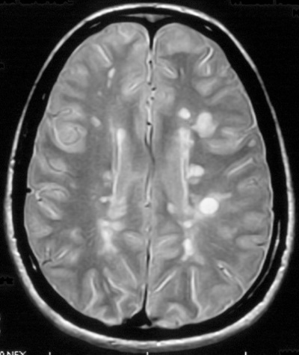
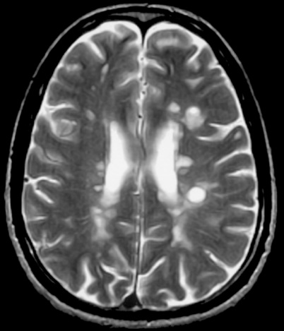
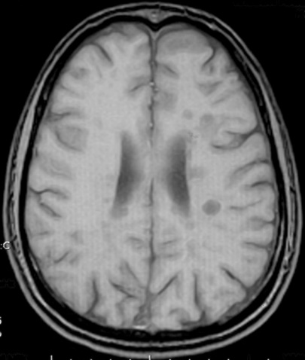
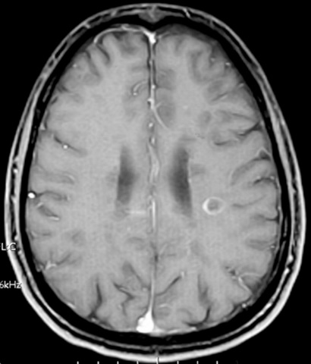
MRI Lesions Provide Useful Secondary Trial Outcomes
spin density
T2
~60% of acute T1 hypointense black holes will resolve within 6-7 months; the remainder persist and indicate severe axonal loss
Kindly provided by Doug Arnold, MD
T1 pre Gd
T1 post Gd

Slide 10
Existing and Emerging MS Therapeutics
Other
Phase I
Lymphocyte trafficking
BIIB033
CS-0777
Phase II
Idebenone
= Oral administration
= Injectable
Interferons
Phase III
Firategrast
Marketed
ONO-4641
ELND-002
Siponimod
Peg IFNβ 1a
Ponesimod
AZD5904
IFNβ-1b
Fingolimod
GRC4039
IFNβ-1a im
Natalizumab
IFNβ-1a sc
Laquinimod
CCX-140
Azathioprine
Immune regulation
Mitoxantrone
Dimethyl fumarate
AIN457
Antiproliferative
agents
Teriflunomide
GA
Daclizumab
Cladribine
THC:CBD
Secukinumab
NI-0801
GA generics x2
4-AP
Pixantrone
GA 40 tiw
Ocrelizumab
IPX-056
Alemtuzumab
RPI-78M
ATX-MS-1467
Ofatumumab
Nerispirdine
PI2301
Symptomatic Therapies
Vaccine, tolerization
RTL1000
LY-2127399
Belimumab
Cytolytic Monoclonal Antibodies
Adapted from Mark Freedman, 2017
Notes:
Revised for Ocrevus only 3/29/17 – need to periodically review and revise others
First interferon approved USA 1992

Slide 11
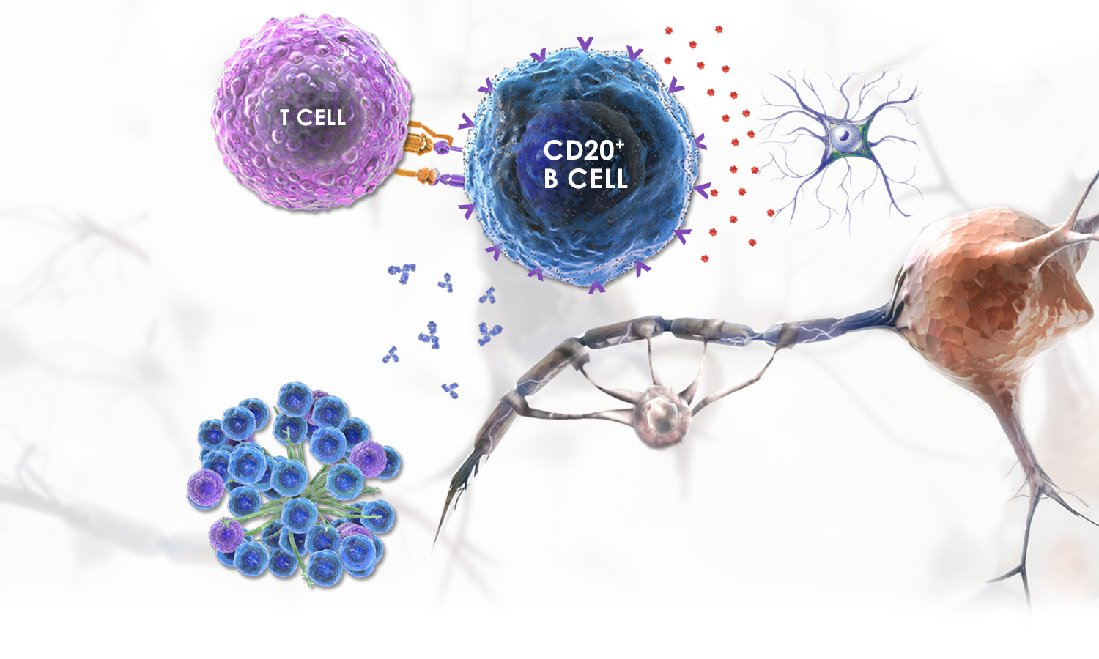
T and B-cell interactions relevant to MS
Cytokine production^{2,3}
Antigen presentation^{1,2}
Autoantibody production⁴
Systemic lymph node follicules
and leptomeningeal lymphoid aggregates^{5,6}
Crawford A, et al J Immunol 176:3498–506, 2006; Bar-Or A, et al Ann Neurol 67:452–61, 2010; Lisak RP, et a. J Neuroimmunol 246:85–95, 2012; Weber MS, et al Biochim Biophys Acta 1812:239–45, 2011; Serafini B, et al Brain Pathol 14:164–74, 2014; Magliozzi R, et al Ann Neurol 68:477–93, 2010

Slide 12
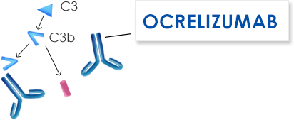
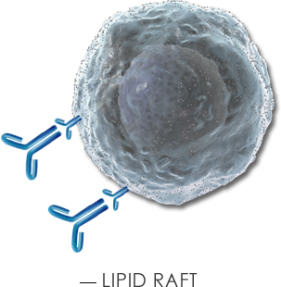
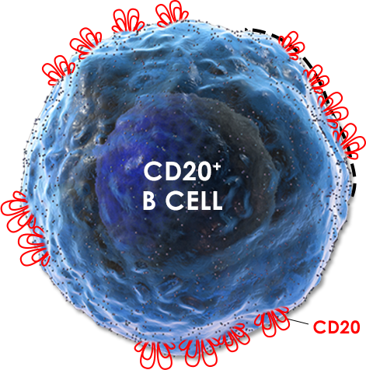
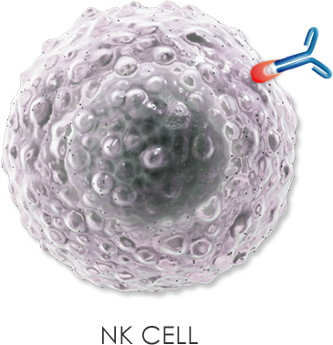
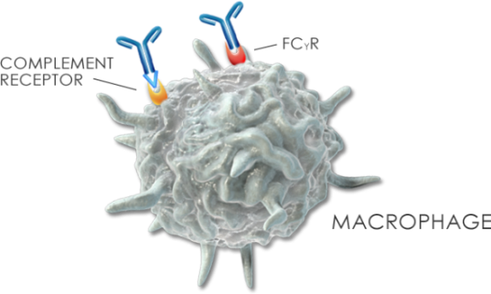
Anti-CD20 biologicals
COMPLEMENT-DEPENDENT
CYTOTOXICITY¹⁻³
ANTIBODY-DEPENDENT CELLULAR CYTOTOXICITY¹⁻³
DIRECT APOPTOSIS¹⁻³
ANTIBODY-DEPENDENT CELLULAR PHAGOCYTOSIS¹⁻³
Jaglowski SM, et al Blood 116:3705–14,2010; Winiarska M, et al Front Biosci 16:277–306, 2011;
Klein C, et al MAbs 5:22–33, 2013

Slide 13
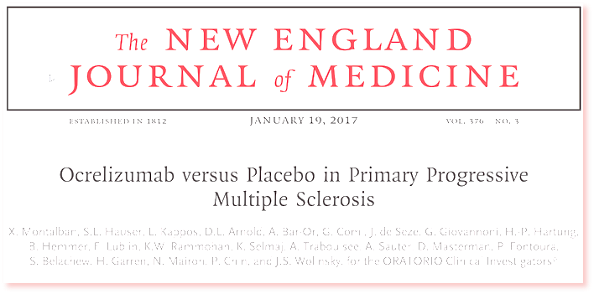
Trial Design

Slide 14
Primary Progressive - OLYMPUS
Inclusion criteria:
18–65 years
EDSS 2.0–6.5
Diagnosis of PPMS (McDonald 2005)
Evidence of disease progression including pyramidal functional system score ≥2 or gait impairment
Positive CSF
Inclusion Criteria
Age 18–55
Baseline EDSS 3.0–6.5
Exclusion Criteria
Patients with EDSS ≥5 and duration from onset ≥15 yrs
Patients with EDSS <5 and duration from onset ≥10 yrs
Rituximab
Placebo
0.7
0.7
Hazard Ratio: 0.53 (95% CI: 0.33, 0.87); P=0.0100
0.6
Hazard Ratio: 0.77 (95% CI: 0.55, 1.09); P=0.1442
0.6
0.5
0.5
Proportion of subjects with
confirmed disease progression
Proportion of subjects with
confirmed disease progression
0.4
0.4
0.3
0.3
0.2
0.2
0.1
0.1
0
0
0
12
24
36
48
60
72
84
96
108
0
12
24
36
48
60
72
84
96
108
Time to confirmed disease progression (weeks)
Patients at risk
Time to confirmed disease progression (weeks)
Patients at risk
Placebo
147
142
131
116
110
103
95
87
58
0
Placebo
75
70
64
53
50
46
41
38
23
0
Rituximab
292
269
253
231
216
208
194
185
136
1
Rituximab
151
141
133
121
113
110
105
100
73
0
Primary Analysis (n=439)
Modified Criteria (n=225)
Hawker et al. Ann Neurol 66:460-471, 2009
Notes:
12 Week SDP: Modified Inclusion/Exclusion Criteria

Slide 15
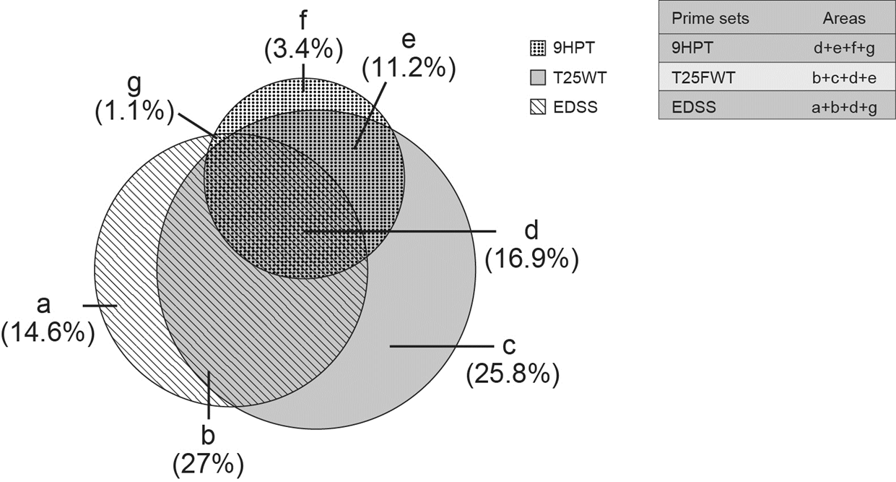
How Additional Clinical Components Perform
 | Meeting SDP of 147
Group | 12 week | 24 week
a | 13 (14.6%) | 10 (12.7%)
b | 12 (27.0%) | 19 (24.1%)
c | 23 (25.8%) | 26 (32.9%)
d | 15 (16.9%) | 11 (13.9%)
e | 10 (11.2%) | 7 (8.9%)
f | 3 (3.4%) | 4 (5.1%)
g | 1 (1.1%) | 7 (8.9%)
All | 89 (60.5%) | 79 (53.7%)
PASAT or SDMT
Low Contrast Visual Sensitivity
Optical Coherence Tomography
Zhang et al. MSJ 20:1494-201, 2014
Notes:
Olympus Trial of rituximab in PPMS

Slide 16
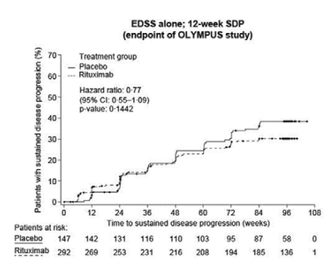
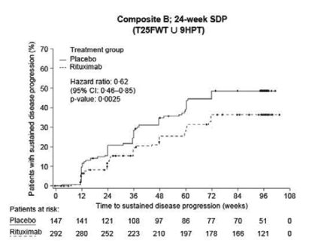
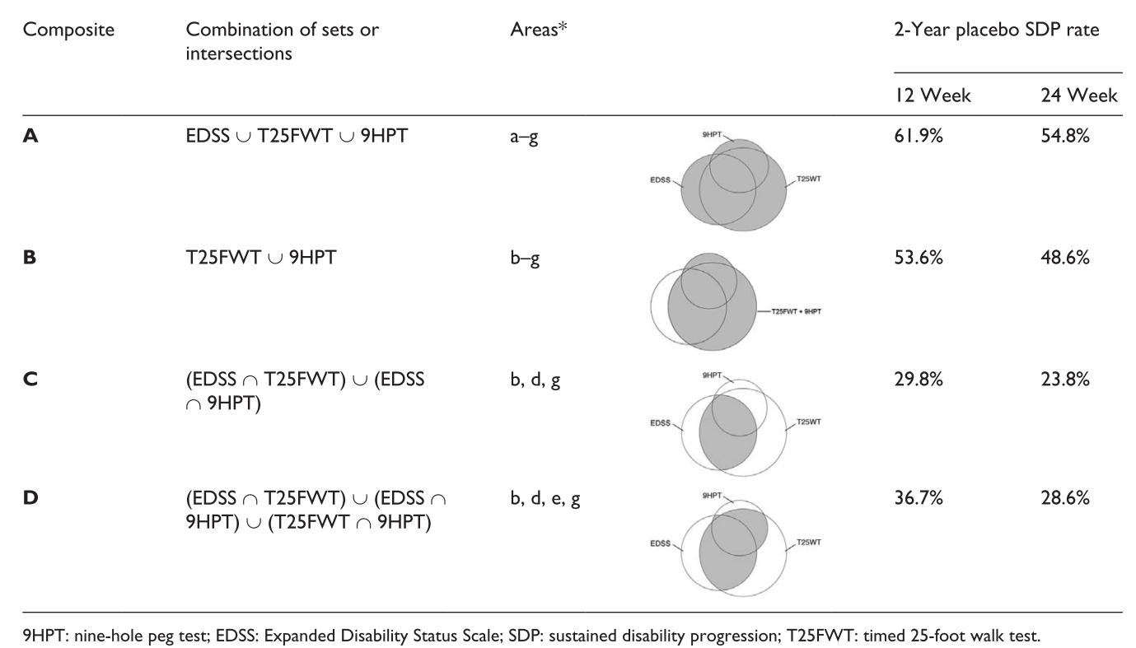
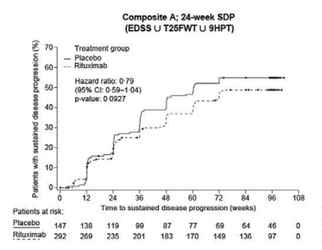
Novel Clinical Composite Outcomes - OLYMPUS
Post hoc Simulation on Trial Data
Zhang et al. MSJ 20:1494-201, 2014
Notes:
Olympus Trial of rituximab in PPMS

Slide 17
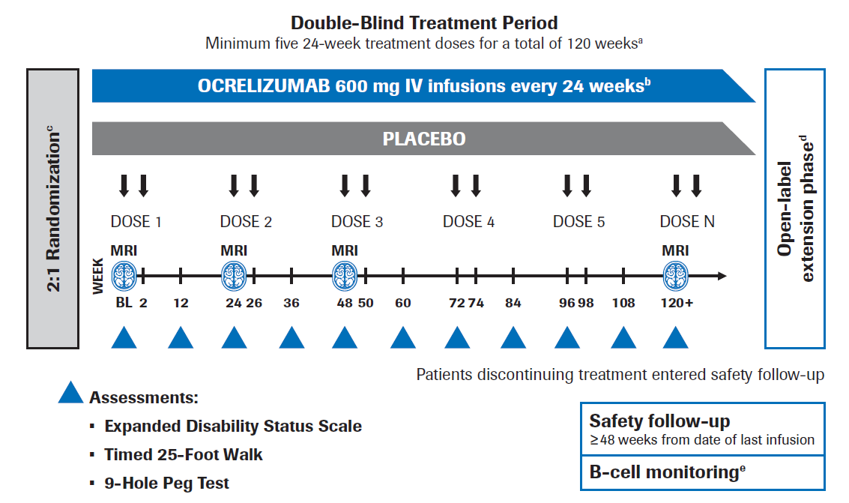
Oratorio Trial Overview
The 2-year progression rate of 12-week confirmed disability was estimated to be 30% for the ocrelizumab group and 43% for the placebo group (hazard ratio 0.635). Using a log-rank test, a sample of 630 patients, randomized in 2:1 ratio between ocrelizumab and placebo groups, would provide 80% statistical power to maintain a type I error rate of 0.01 with 253 events expected (assuming an exponential dropout rate of 20% over 2 years).
ªThe blinded treatment period continued until the last patient completed 120 weeks and target of 253 CDP events was reached
^{b}Patients received methylprednisolone prior to each ocrelizumab or placebo infusion
^{c}2:1 randomization stratified by age (≤45 vs >45 years) and region (USA vs rest of the world)
^{d}Patients who declined to participate in the OLE entered safety follow-up
^{e}Continued monitoring occurred if B cells were not repleted.
BL, baseline; CDP, confirmed disability progression; IV, intravenous; MRI, magnetic resonance imaging; OLE, open-label extension.
Notes:
Statistical Analysis
The sample size for this study was based on data from a previous trial in patients with primary progressive multiple sclerosis (Hawker K, et al. Ann Neurol 2009;66:460-71); the 2-year progression rate of 12-week confirmed disability was estimated to be 30% for the ocrelizumab group and 43% for the placebo group (hazard ratio 0.635). Using a log-rank test, a sample of 630 patients, randomized in 2:1 ratio between ocrelizumab and placebo groups, would provide 80% statistical power to maintain a type I error rate of 0.01 with 253 events expected (assuming an exponential dropout rate of 20% over 2 years). Five secondary efficacy endpoints were tested in hierarchical order if the primary endpoint and each preceding endpoint reached a two-sided alpha of 0.05.

Slide 18
Secondary Efficacy Analyses
Hierarchical testing of each secondary efficacy endpoint was performed in the following order:
Time to onset of confirmed disability progression sustained for ≥24 weeks
Change in timed 25-foot walk from baseline to Week 120
Change in total volume of brain T2 hyperintense lesions from baseline to Week 120
Change in total brain volume from Week 24 to Week 120
Change from baseline in quality of life as measured by the SF-36 (physical component)
Change in timed 25-foot walk and total volume of brain T2 hyperintense lesions from baseline to Week 120 were assessed using ranked analysis of covariance (ANCOVA) for P-value and a mixed effect model repeated measures (MMRM) for treatment estimates.
Change in total brain volume from Week 24 to Week 120 and change from baseline in SF-36 (physical component) were assessed using MMRM.
Total number of new and/or enlarging T2 hyperintense lesions as detected by brain MRI was assessed using a negative binomial model. Percentage change in total brain volume from baseline to Week 120 was assessed using an MMRM analysis.
Pre-defined Exploratory Analyses
The Statistical Analysis Plan defined 5 MRI-derived endpoints, 7 clinical and 2 pharmacokinetic/dynamic endpoints. Not all of these have been completed, nor have multiple post hoc analyses generated in concert with the Steering Committee to explore in depth issues arising reached completion.

Slide 19
Efficacy

Slide 20
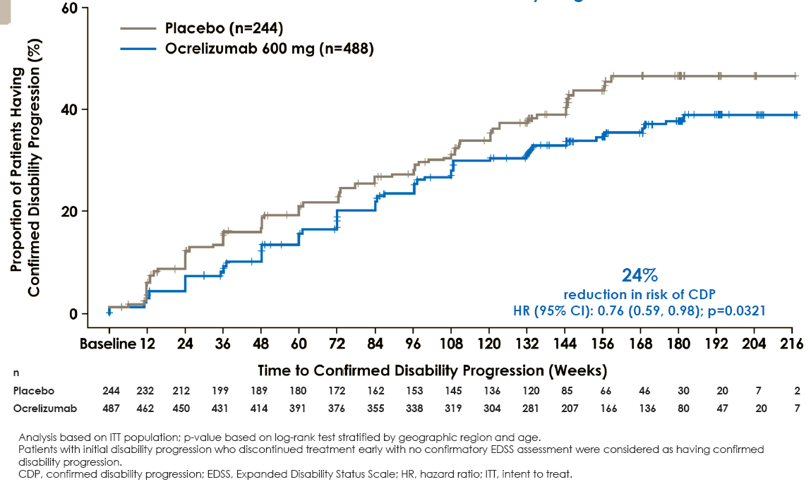
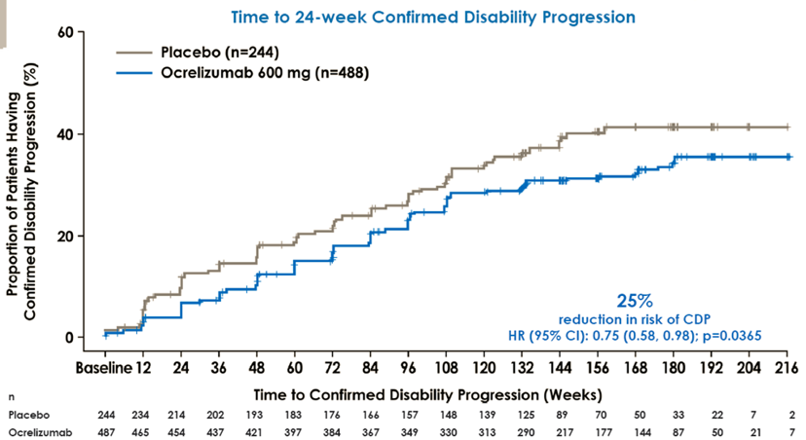
Oratorio – The Essential Primary Outcome
Inclusion criteria:
Diagnosis of PPMS (variant McDonald 2005)
≥1 year of disease progression plus two of three criteria: positive brain MRI; positive spinal cord MRI; AND positive CSF
Age 18–55 years
EDSS 3.0–6.5
Notes:
Compared with PBO, OCR significantly reduced the risk of 12- (24% [p=0.0321]) and 24-week CDP (25% [p=0.0365]); 25-foot walk progression rate (29% [OCR: +39%, PBO: +55%; p=0.0404]); T2 lesion volume (OCR: -3.4%, PBO: +7.4% [p<0.0001]); and brain volume loss rate (17.5% [OCR: -0.9%, PBO: -1.1%; p=0.0206]).

Slide 21
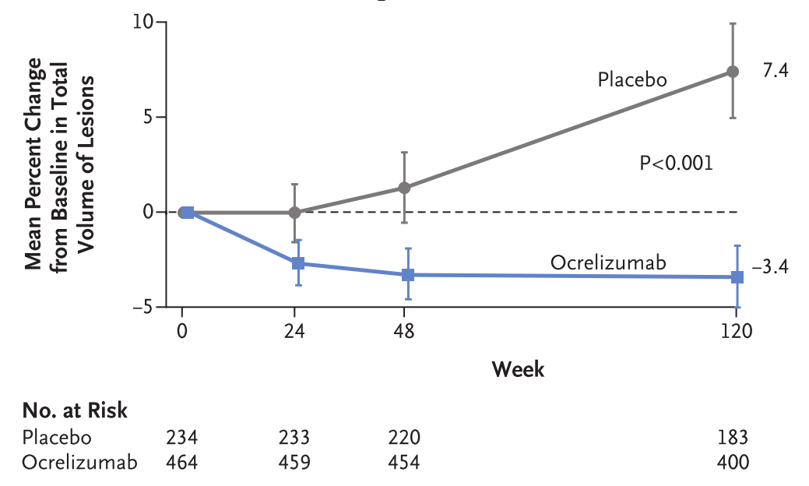
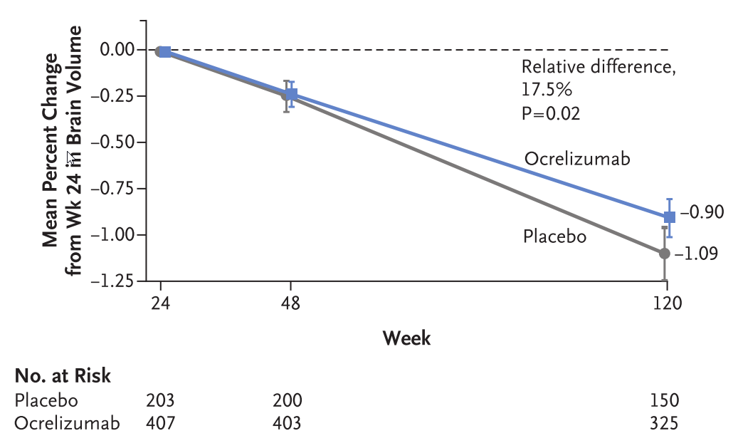
Oratorio – Effects on Evolving Pathology

Slide 22
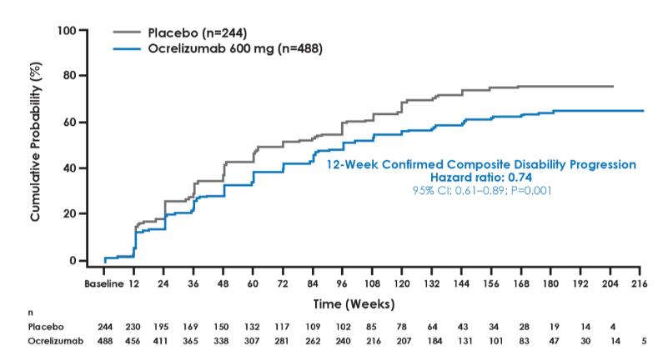
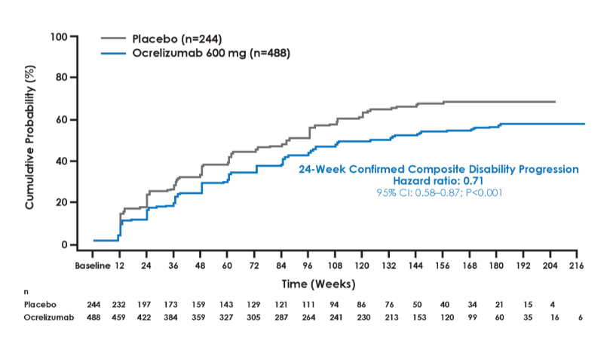
Oratorio – Effects on Composites

Slide 23
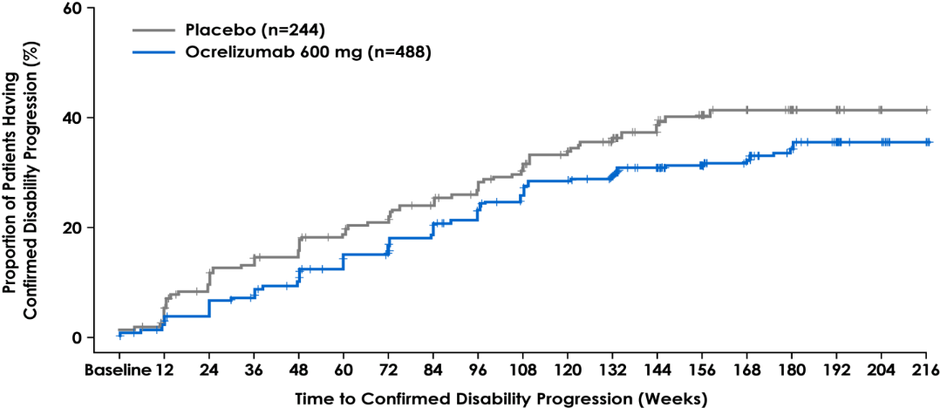
Probing the Data
Overall Study Population
25%
reduction in risk of CDP
HR (95% CI): 0.75 (0.58, 0.98);
p-value (log rank)=0.0365*
 | Placebo (N=244) |  | Ocrelizumab (N=488) |  | Hazard Ratio | 95% CI
 | n | Events | n | Events
Overall population | 244 | 87 | 487 | 144 | 0.75 | (0.58, 0.98)
≥T1 Gd⁺ lesions | 60 | 23 | 133 | 39 | 0.67 | (0.40, 1.14)
No T1 Gd⁺ lesions | 183 | 63 | 350 | 103 | 0.81 | (0.59, 1.10)
*Analysis based on ITT population; p-value based on log-rank test stratified by geographic region and age. Patients with initial disability progression who discontinued treatment early with no confirmatory EDSS assessment were considered as having confirmed disability progression.
CDP, confirmed disability progression; Gd⁺, gadolinium-enhancing; EDSS, Expanded Disability Status Scale; HR, hazard ratio; ITT, intent to treat.
Wolinsky et al American Academy of Neurology Vancouver, 2016

Slide 24
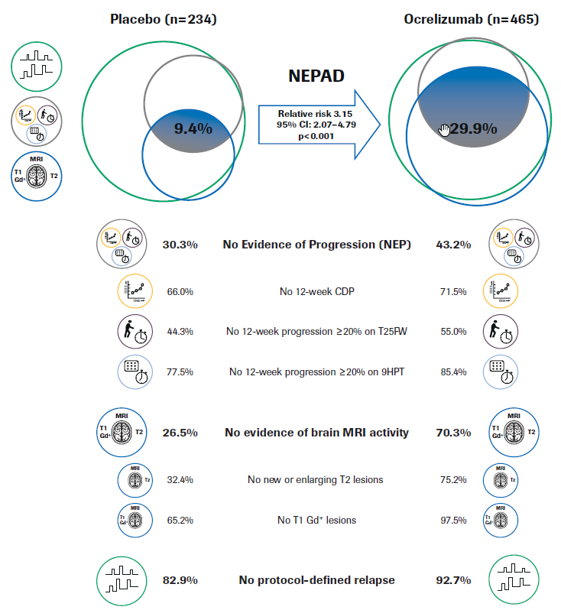
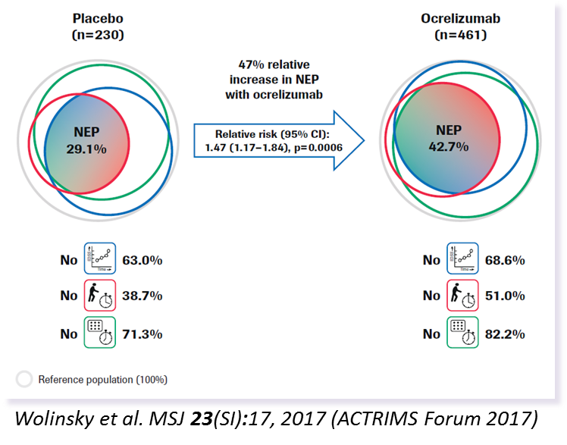
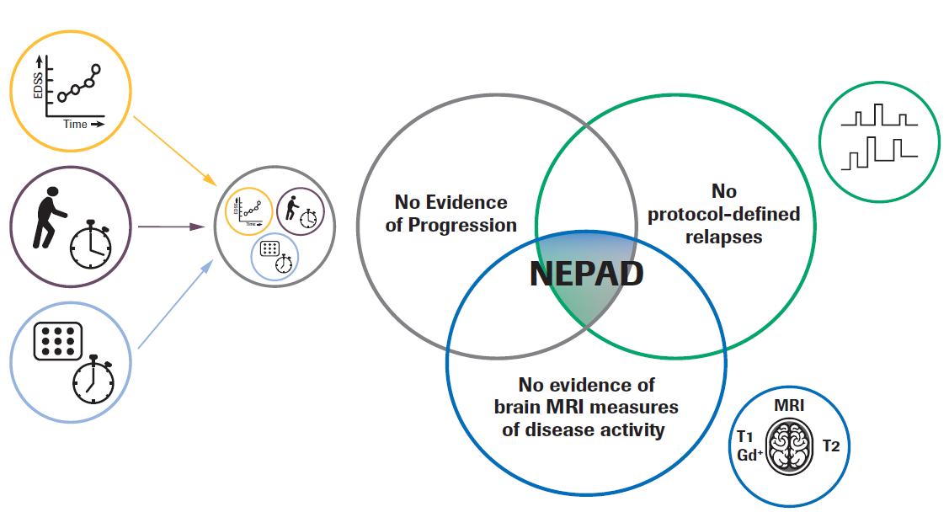
How much disease can be contained?
Wolinsky et al Neurology 88(S16):P4.384, 2017
Notes:
Exploratory analysis; the relative risk and p-value are from a Cochran–Mantel–Haenszel test stratified by age (≤45 vs >45 years) and region (USA vs rest of the world). NEPAD reference population is a modified ITT population. Patients who discontinued treatment early with at least one event prior to discontinuation were considered as having EPAD. Patients with no reported event before early discontinuation were considered as having EPAD if the reason for early treatment discontinuation was reported to be lack of efficacy or death; otherwise, they were excluded from the analysis. In this approximately surface-proportional Venn diagram representation, the sector including two ocrelizumab patients with protocol-defined relapse but with no MRI activity and NEP cannot be displayed.
9HPT, 9-Hole Peg Test; CDP, confirmed disability progression; CI, confidence interval; EPAD, evidence of progression or active disease; Gd+, gadolinium-enhancing; ITT, intent to treat; MRI, magnetic resonance imaging; NEP, no evidence of progression; NEPAD, no evidence of progression or active disease; OCR, ocrelizumab; T25FW, Timed 25-Foot Walk.

Slide 25
Safety
Notes:
The safety population included all patients who received at least one dose of study drug (ocrelizumab or placebo). This population was used for all summaries of safety data. Patients randomized to the placebo group who received at least one dose of ocrelizumab (n=4) were summarized in the ocrelizumab group.
Serious adverse events definition A serious adverse event is defined as any adverse event that, at any dose, fulfills at least one of the following criteria:
Is fatal (results in death*; please note: death is an outcome, not an event)
Is life-threatening (please note: the term “life-threatening” refers to an event in which the patient was at immediate risk of death at the time of the event; it does not refer to an event which could hypothetically have caused a death had it been more severe)
Requires in-patient hospitalization or prolongation of existing hospitalization
Results in persistent or significant disability/incapacity
Is a congenital anomaly/birth defect
Is medically significant or requires intervention to prevent one or other of the outcomes listed above.
* The term “sudden death” should only be used when the cause is of a cardiac origin as per standard definition. The terms “death” and “sudden death” are clearly distinct and must not be used interchangeably.

Slide 26
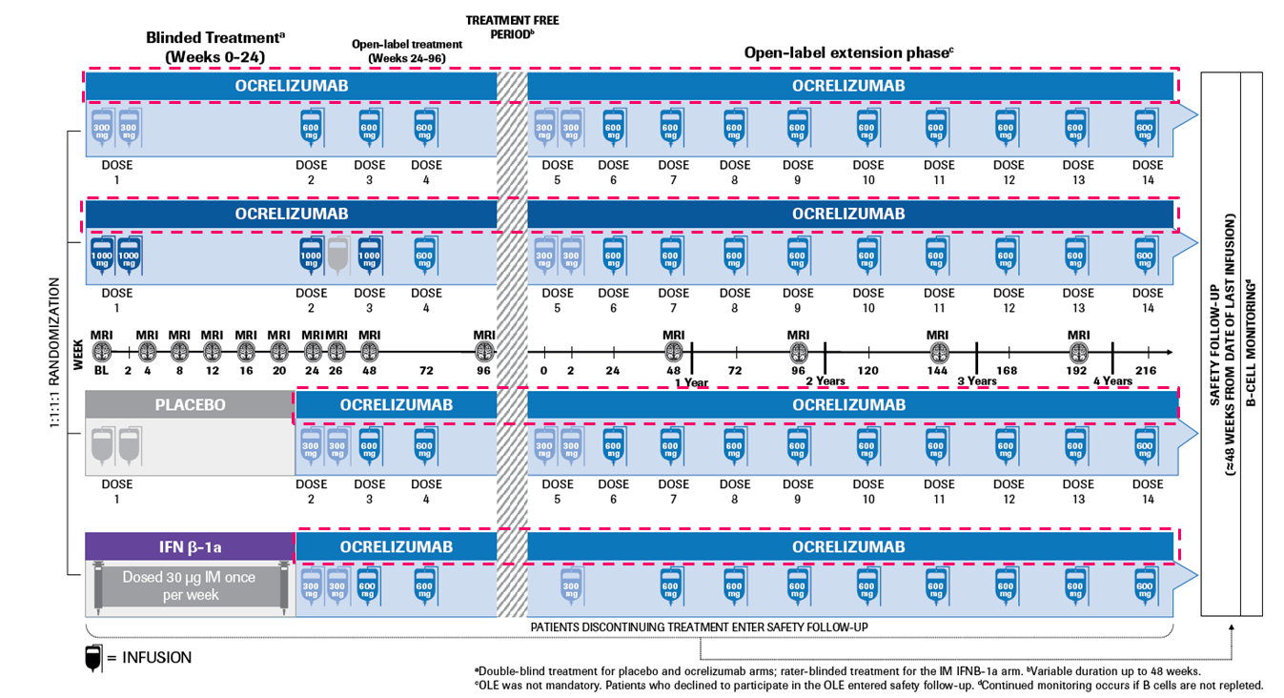
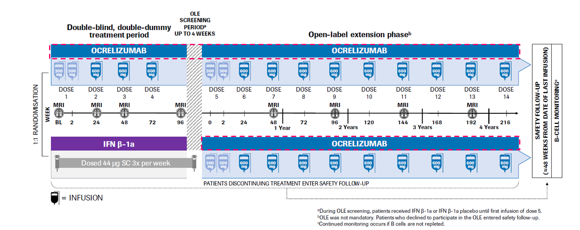
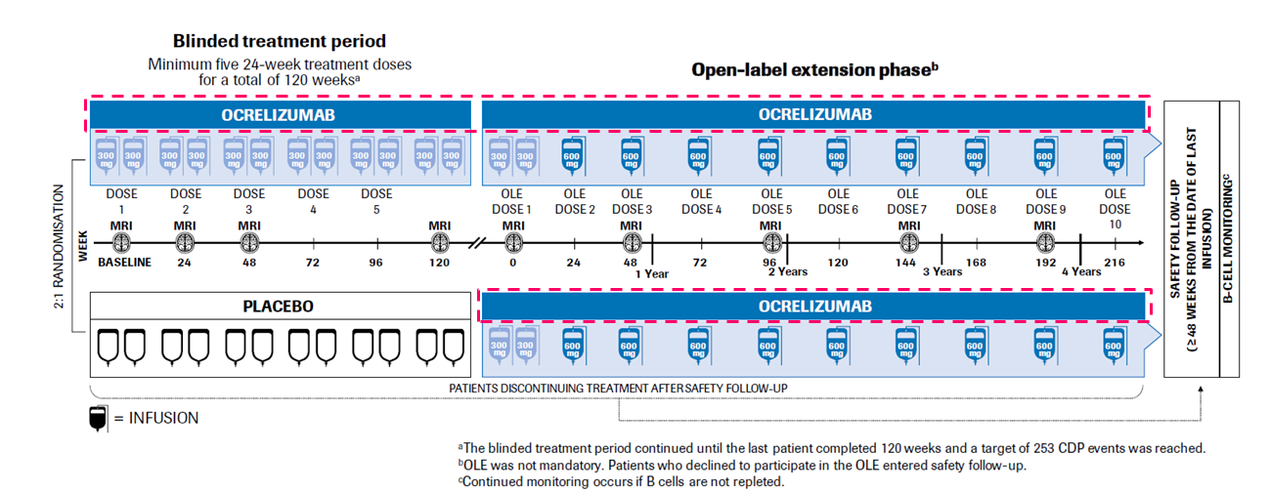
Ocrelizumab – Integrated Safety Summary (1)
Phase 2 Study
Ocrelizumab All Exposure Group
(included in safety analysis)
Phase 3 Opera Studies
Phase 3 Oratorio Study
Kappos et al Neurology 88(S16):P5.407, 2017
Notes:
This safety analysis includes all patients who received ≥1 dose of ocrelizumab during the controlled or open-label periods of the Phase II and Phase III studies as of January 20, 2016 - Findings from the integrated summary of safety (ISS), based on the earlier clinical cut-off dates of the individual studies (Phase II, January 22, 2015; OPERA I, April 2, 2015; OPERA II, May 12, 2015; ORATORIO, July 24, 2015), will be presented for comparison
Additional data cuts available for malignancies (June 30, 2016; September 15, 2016) will also be presented for comparison with further exposure

Slide 27
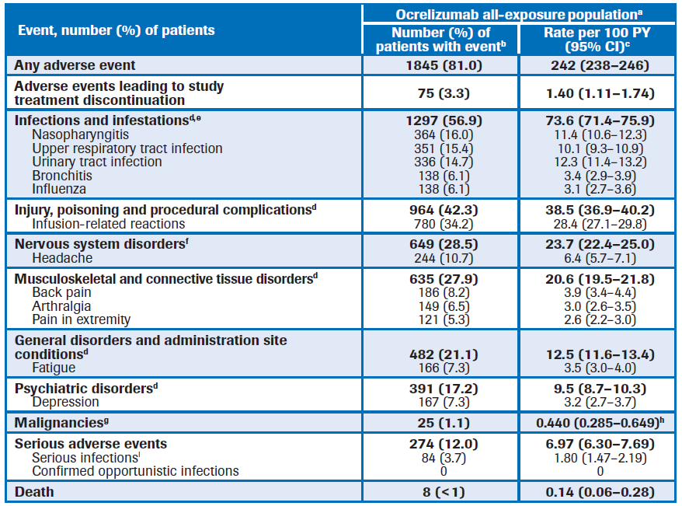
Ocrelizumab – Integrated Safety Summary (2)
Cut off date January 20, 2016 | Ocrelizumab All Exposure (N=2,279)
Total patient years | 5,711
Number of doses
Mean (SD) | 5.6 (2.8)
Median | 6.0
Total cumulative dose (mg)
Mean (SD) | 3,393 (1717)
Median | 3,900
Range | 9−9,420
Kappos et al Neurology 88(S16):P5.407, 2017
Notes:
AE’s in yellow/red exceeding control groups during controlled phases of study
This safety analysis includes all patients who received ≥1 dose of ocrelizumab during the controlled or open-label periods of the Phase II and Phase III studies as of January 20, 2016 - Findings from the integrated summary of safety (ISS), based on the earlier clinical cut-off dates of the individual studies (Phase II, January 22, 2015; OPERA I, April 2, 2015; OPERA II, May 12, 2015; ORATORIO, July 24, 2015), will be presented for comparison
Additional data cuts available for malignancies (June 30, 2016; September 15, 2016) will also be presented for comparison with further exposure

Slide 28
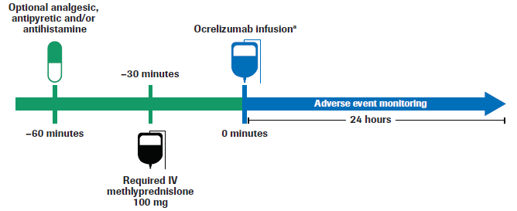
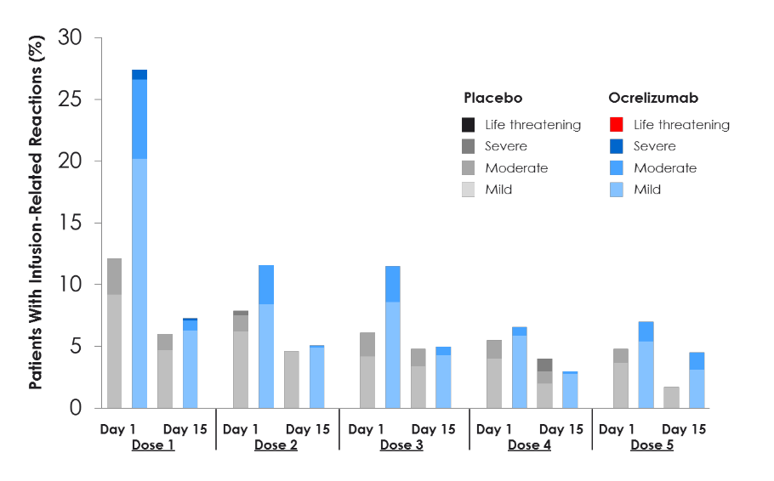
Ocrelizumab – Controlled Phase ORATORIO Infusion Reactions
Common symptoms associated with infusion-related reactions in ocrelizumab treated patients were pruritus, rash, throat irritation, flushing, pyrexia, and headache.
Notes:
Infusion-related reaction definition Investigators were instructed to report all infusion-related reactions (defined as an event that occurred between the start of ocrelizumab/placebo infusion and within 24 hours of the completion of the infusion) together with their corresponding symptoms, on a dedicated form. Infusion-related reactions include all events occurring during infusion, shortly post-infusion (in clinic), or within 24 hours post-infusion. Common symptoms associated with infusion-related reactions in ocrelizumab treated patients were pruritus, rash, throat irritation, flushing, pyrexia, and headache.

Slide 29
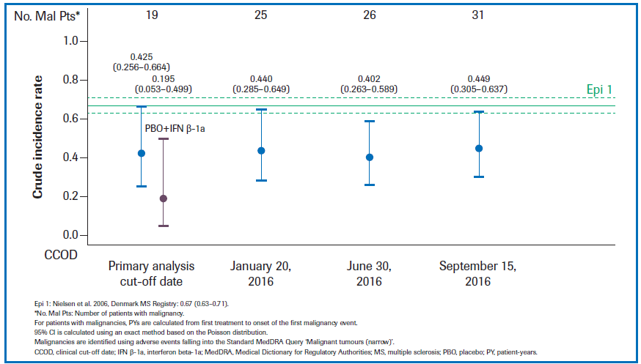
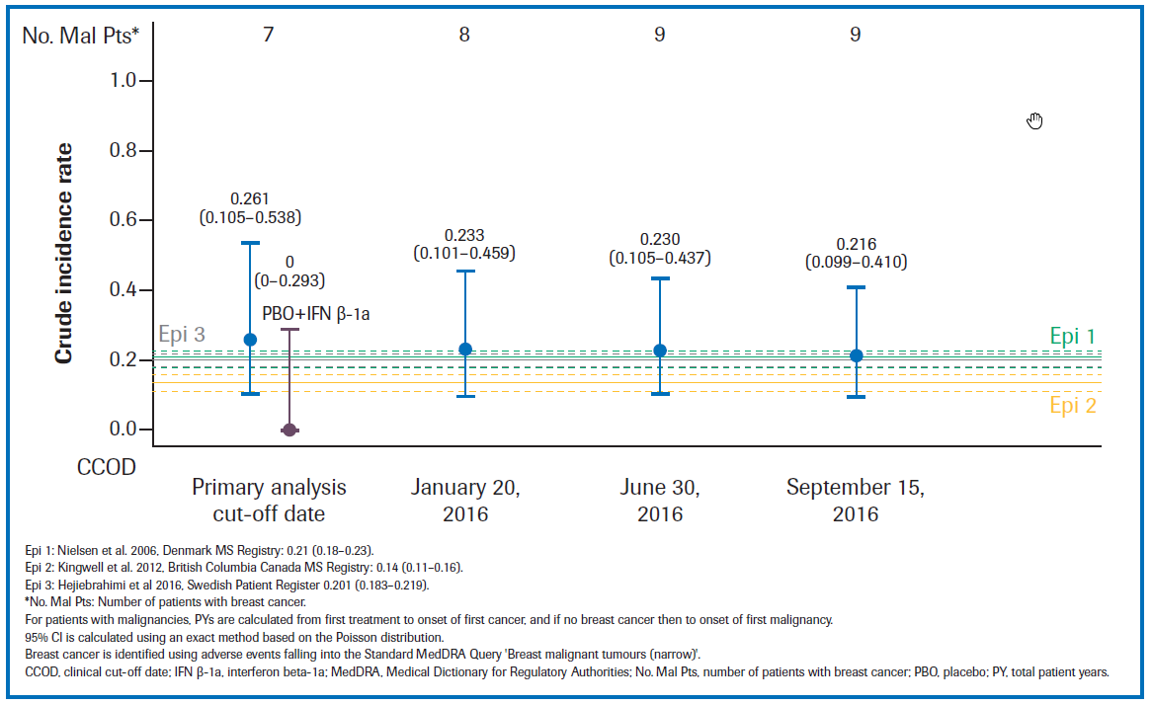
Ocrelizumab – Integrated Safety Summary (3)
Crude Incidence rate/100 patient years: All malignancies over time compared with the Danish MS registry
Crude Incidence rate of breast cancer over time compared with 3 MS registries
Kappos et al Neurology 88(S16):P5.407, 2017
Notes:
Note that cutoff date is September 2016
45 yo female reported during AAN as developing intraductal breast cancer after switch from IFN -> OCR

Slide 30
Summary
ORATORIO was designed to build on lessons learned from prior experience in trials that ventured into progressive phase multiple sclerosis. The data support a major ‘crack in the wall’ signaling a major step forward for an important group of patients until now excluded from evidence based disease modifying therapies.
New outcome measures being considered for progressive phase trials shown responsive to active therapy in ORATORIO, should serve to help planning other approaches to therapeutics in this phase of the disease, in a manner to what has been refined for relapsing phase disease where different endpoints are more informative in shorter trial designs.
These results with highly directed anti-CD20 cell therapies is refocusing our approaches to B-cells as ‘players’ in the systemically-mediated immunopathogenesis of MS.
While risk/benefit appears balanced, we must retain continued diligence to late evolving issues as therapy is extended outside of well-controlled and monitored clinical trials.
The extent to which early intervention in progressive phase disease can attain NEPAR in the presence or absence of ‘purely neuroprotective/repair’ therapeutics is the new frontier.
I hope that the sampling of data emerging from ORATORIO presented has provided some assurance that the every more difficult choice made by this year’s selection committee was well placed.

